Slide 1


Decodelabs project 1 & 2
Name : Hamza Mahmoud
Goal : Discover patterns , trends , and relationships
Tools : python (Pandas , SciPy , seaborn, matplotlib)
Notes:
1

Slide 2
Data cleaning:
Checked dataset for null values
Found 309 missing values in couponcode column where other columns had no null values
Replaced null values by no coupon as dropping 309 rows from a dataset of 1200 rows is inefficient for the assumption that for the null values, they didn’t use a coupon
Found no duplicated rows
Fixed data types of data and determined categorical variables
Now data is clean and structured for exploratory data analysis (EDA) with no data quality errors
Notes:
1

Slide 3
Analysis:
First Divided dataset into 2 type of columns
Numerical columns:
Quantity
Unit price
Total price
Items in cart
Categorical columns:
Product
Coupon code
Payment method
Order status
Referral source
Notes:
1

Slide 4
Numerical measures :
Measure (Rounded to nearest 2) | Quantity | Unit price | Items in cart | Total price
Mean | 2.95 | 356.41 | 5.48 | 1053.97
Mode | 1 | Too many modes | 5 | Too many modes
Median | 3 | 364.21 | 5 | 823.62
Q1 | 2 | 186.06 | 4 | 410.52
Q2 | 3 | 364.21 | 5 | 823.62
Q3 | 4 | 521.57 | 7 | 1578.48
Min | 1 | 11.39 | 1 | 11.39
Max | 5 | 699.93 | 10 | 3456.4
Standard deviation | 1.41 | 197.18 | 2.28 | 819.86
Skewness | 0.03 | -0.03 | 0 | 0.89
Kurtosis | -1.29 | -1.19 | -0.71 | -0.05
Comments :
From the table we can conclude that unit price is negatively skewed and total price is positively skewed while both are less peaked than normal so there is more variation than normal while items in cart is symmetric
Notes:
1

Slide 5
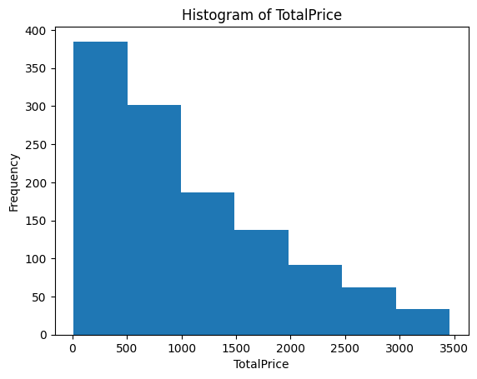
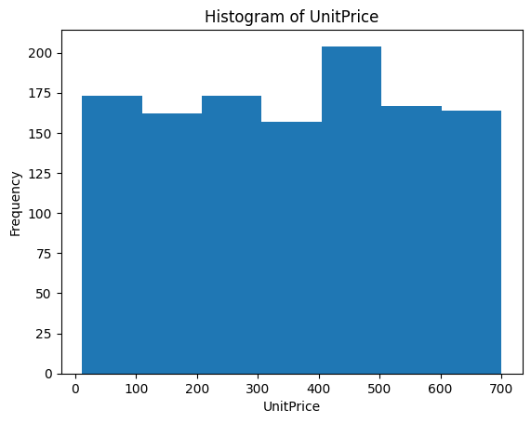
Comment:
This figures show the distribution of total price and unit price using histograms which shows that total price is negatively skewed with the majority of order prices are between 0-500 while unit price doesn’t have major differences between groups
Notes:
1

Slide 6
Categorical measures :
product | Frequency | Relative Frequency
Printer | 181 | 15.08%
Tablet | 179 | 14.92%
Chair | 178 | 14.83%
Laptop | 173 | 14.42%
Desk | 170 | 14.17%
Monitor | 163 | 13.58%
Phone | 156 | 13%
Payment method | Frequency | Relative Frequency
Online | 258 | 21.5%
Cash | 246 | 20.5%
Credit card | 234 | 19.5%
Debit card | 232 | 19.33%
Gift card | 230 | 19.17%
Order status | Frequency | Relative Frequency
Cancelled | 250 | 20.83%
Returned | 247 | 20.58%
Pending | 237 | 19.75%
Shipped | 235 | 19.58%
Delivered | 231 | 19.25%
Coupon code | Frequency | Relative Frequency
Freeship | 313 | 26.08%
No coupon | 309 | 25.75%
Winter15 | 292 | 24.33%
save10 | 286 | 23.83%
Referral source | Frequency | Relative Frequency
Instagram | 259 | 21.58%
Email | 250 | 20.83%
Google | 241 | 20.08%
Facebook | 228 | 19%
Other referrals | 222 | 18.5%
These Tables were used to identify categories distribution and most common category for each categorical column
Notes:
1

Slide 7
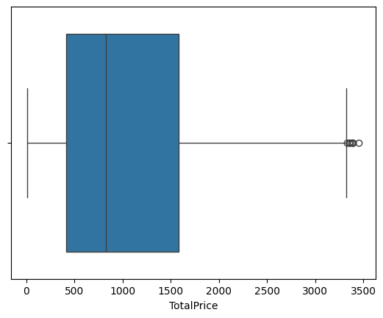
Outliers:
We found no outliers for Quantity, Unit price and items in cart
We found 8 outliers for total price for the following orders
Order Id | Total price
ORD200107 | 3353.75
ORD200326 | 3352.4
ORD200328 | 3370.2
ORD200469 | 3384.9
ORD200632 | 3390.8
ORD200789 | 3456.4
ORD201065 | 3334
ORD201122 | 3390.95
Notes:
1

Slide 8
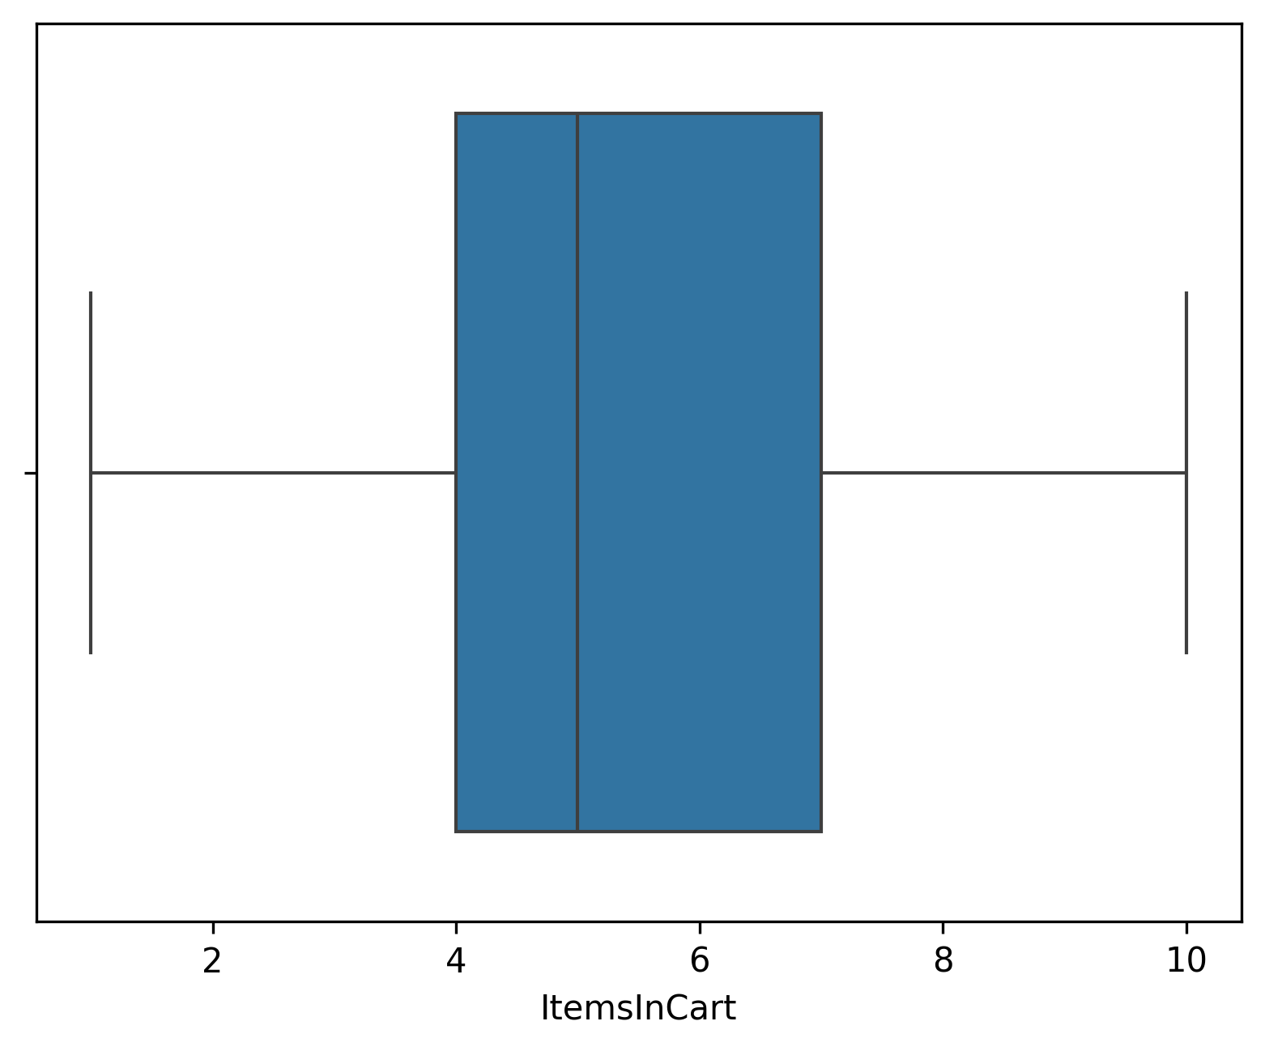
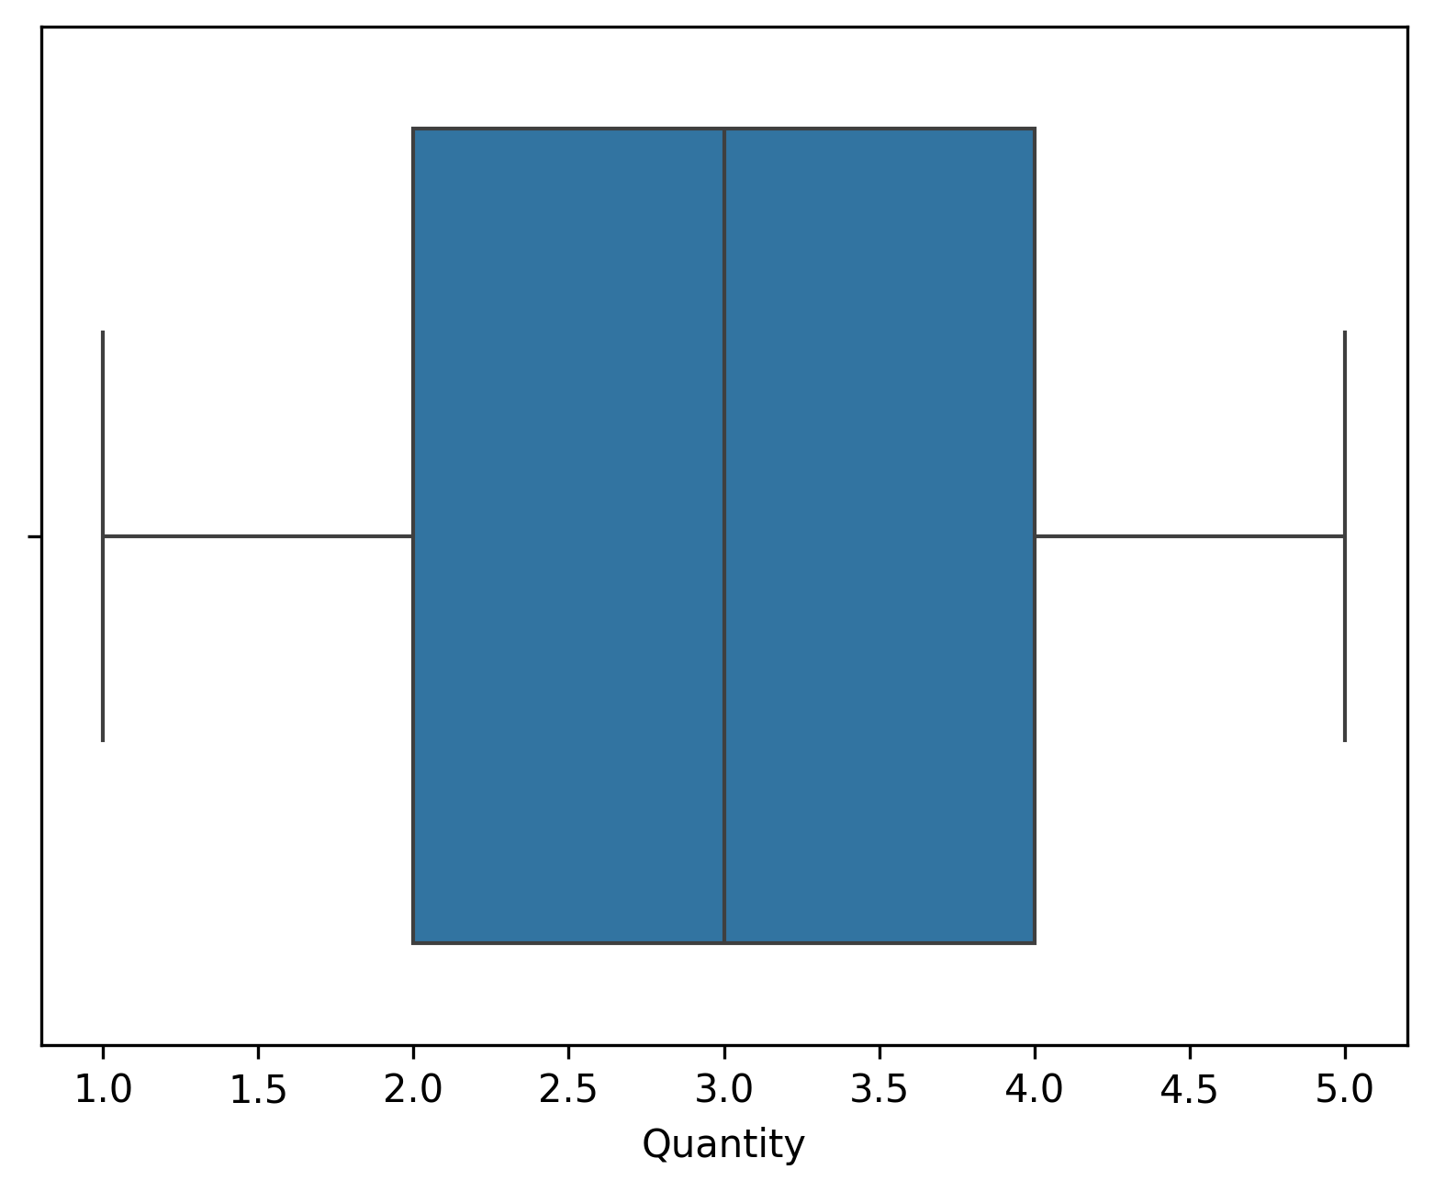
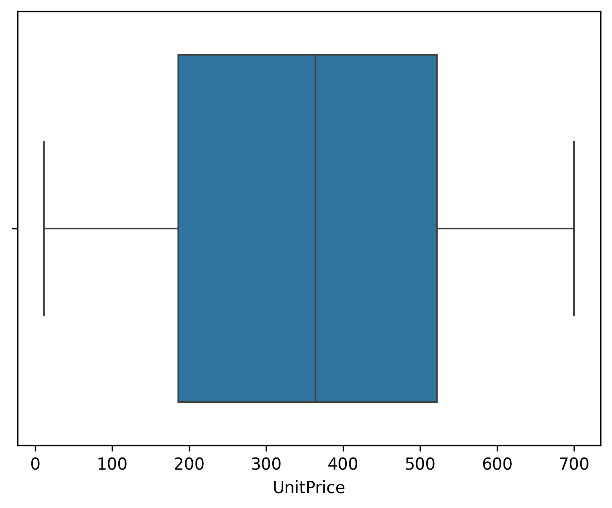

There boxplots gives us same conclusion as last slide in which only total price has outliers
Notes:
1

Slide 9
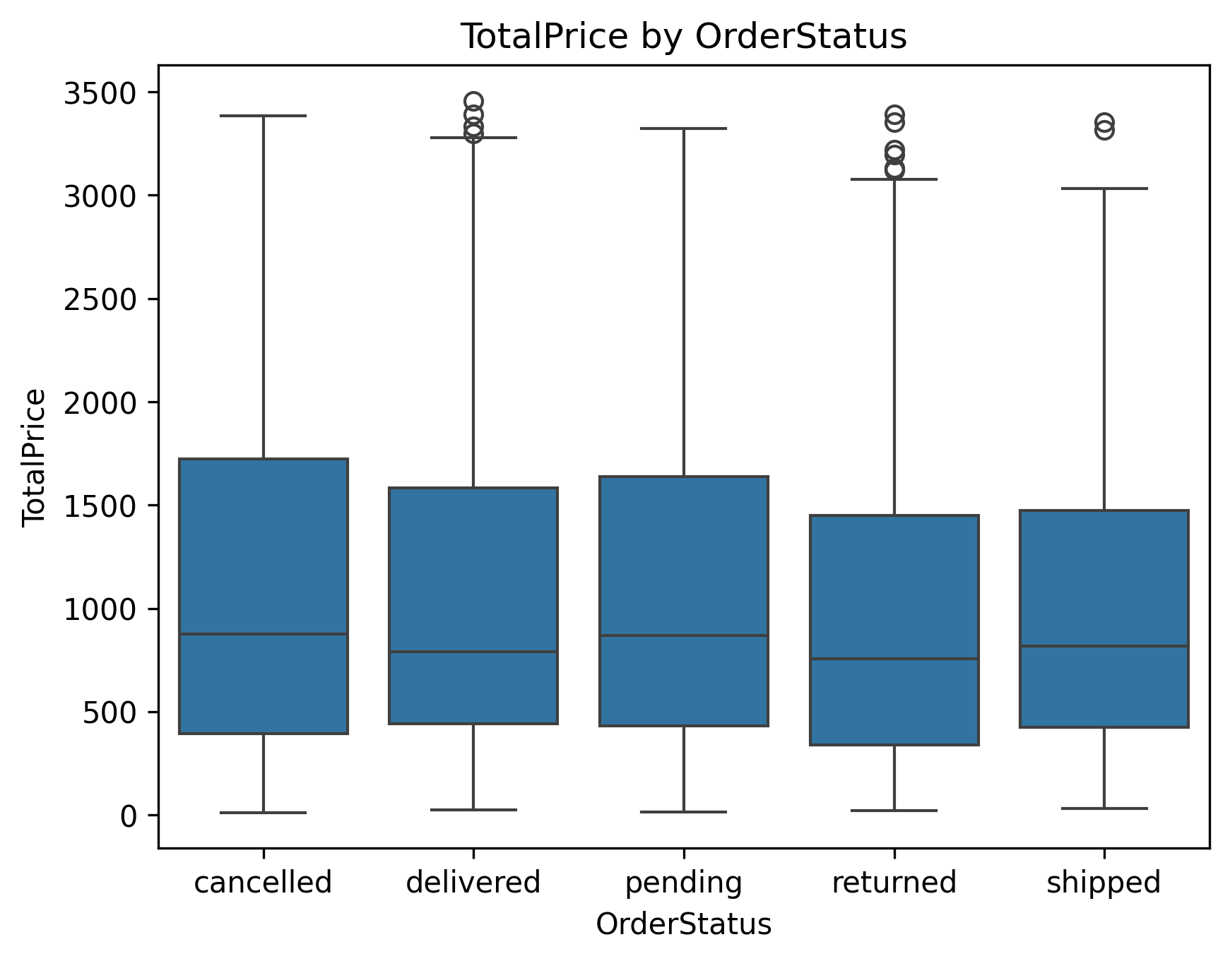
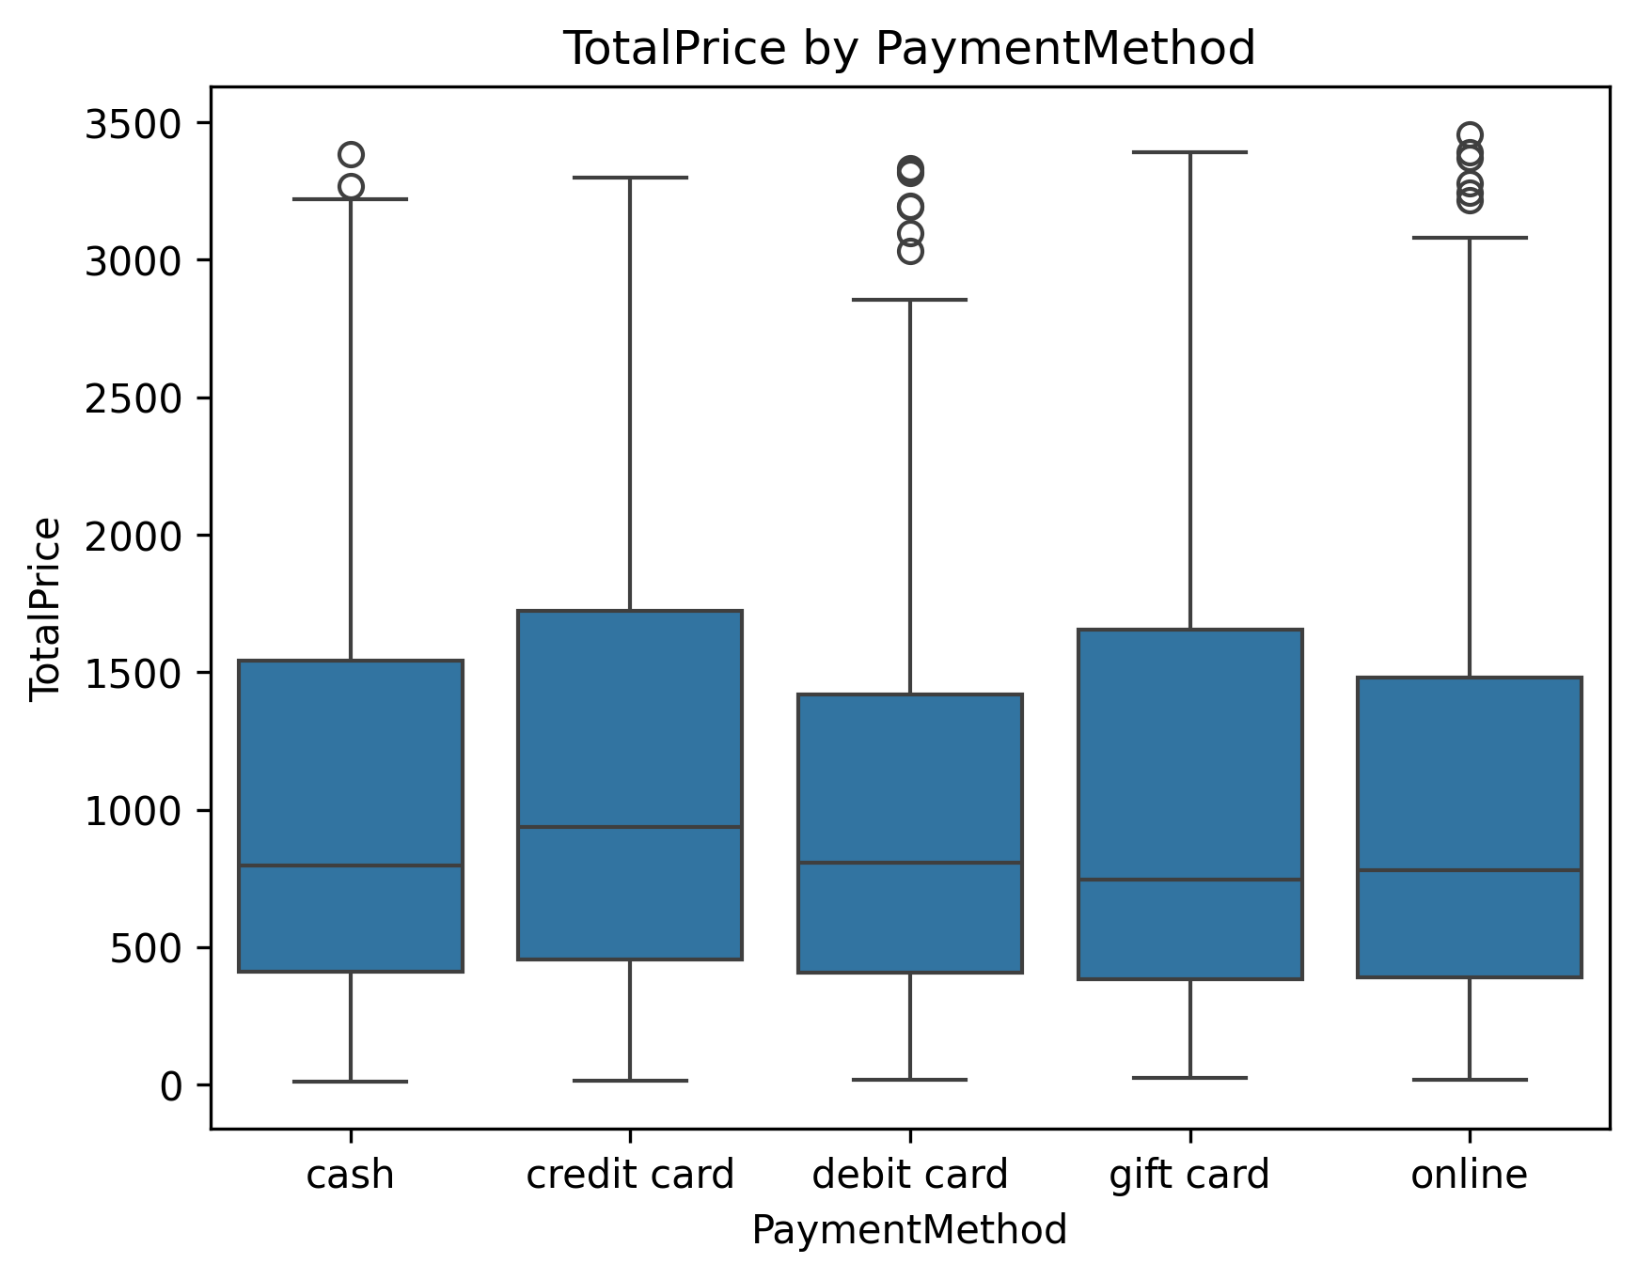
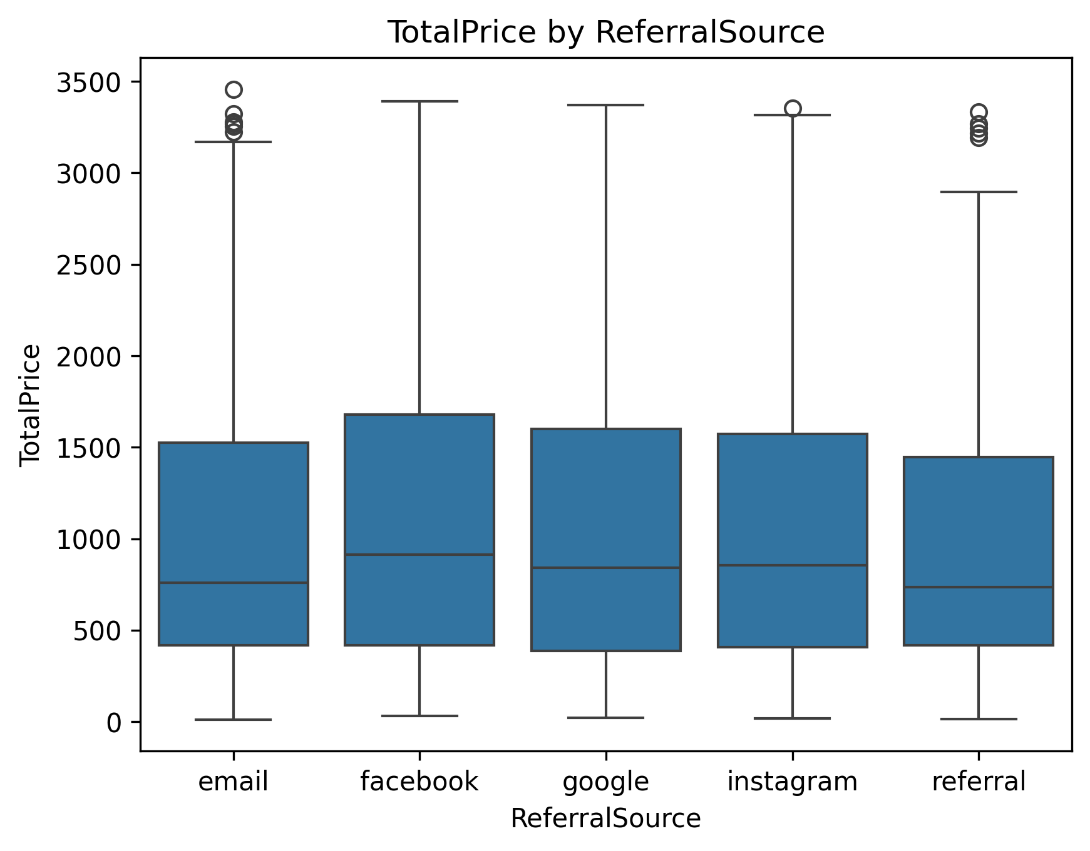
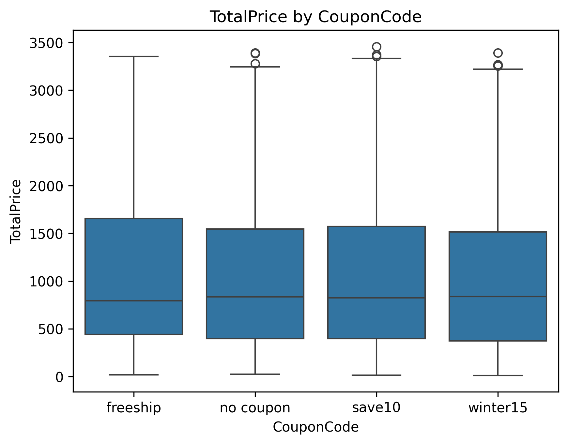
These four figures are boxplots for total price divided among several categories which shows that the outliers for total price for all our categories
Notes:
1

Slide 10
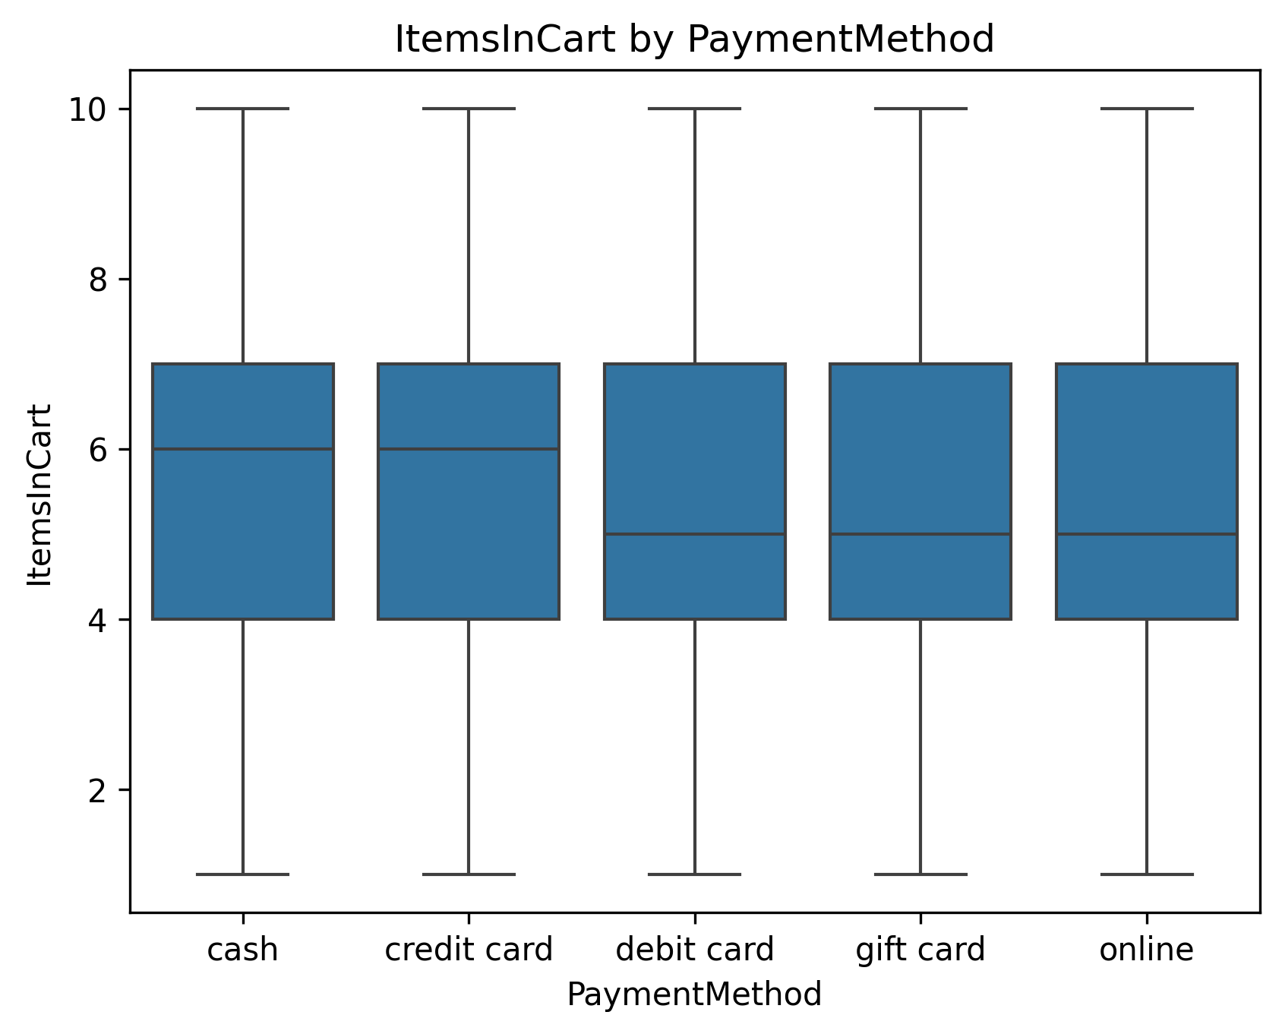

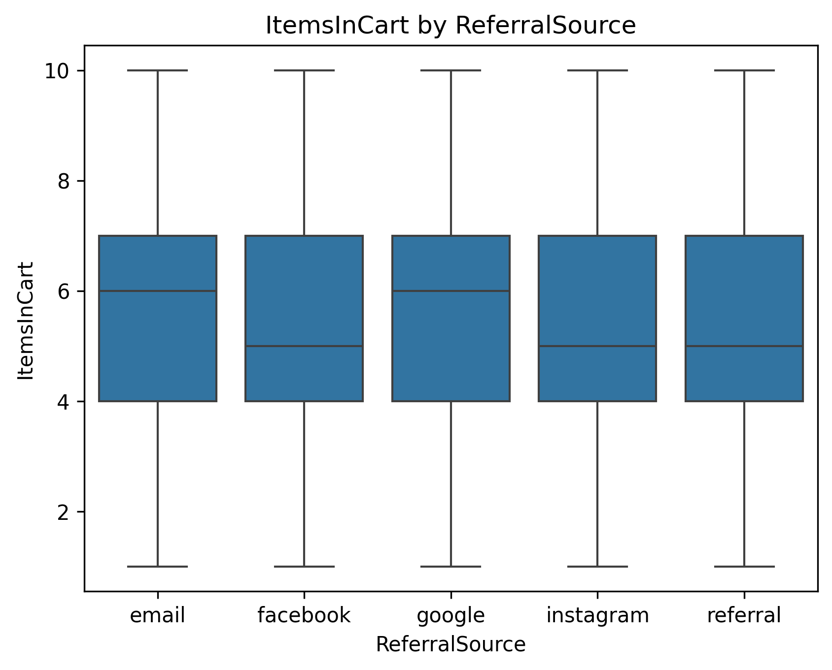
These four figures are boxplots for items in cart divided among several categories which shows that there no outliers for items in cart for all our categories
Notes:
1

Slide 11
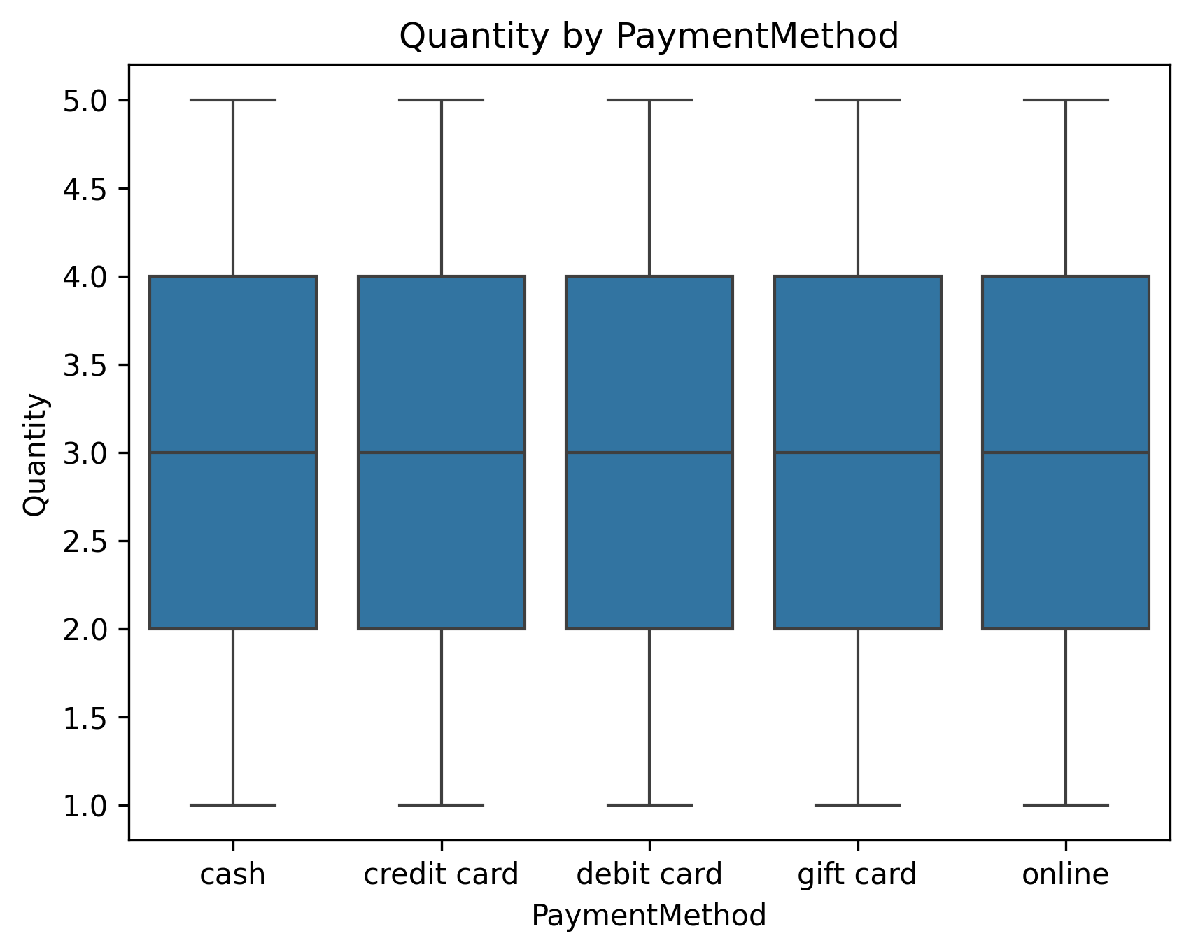
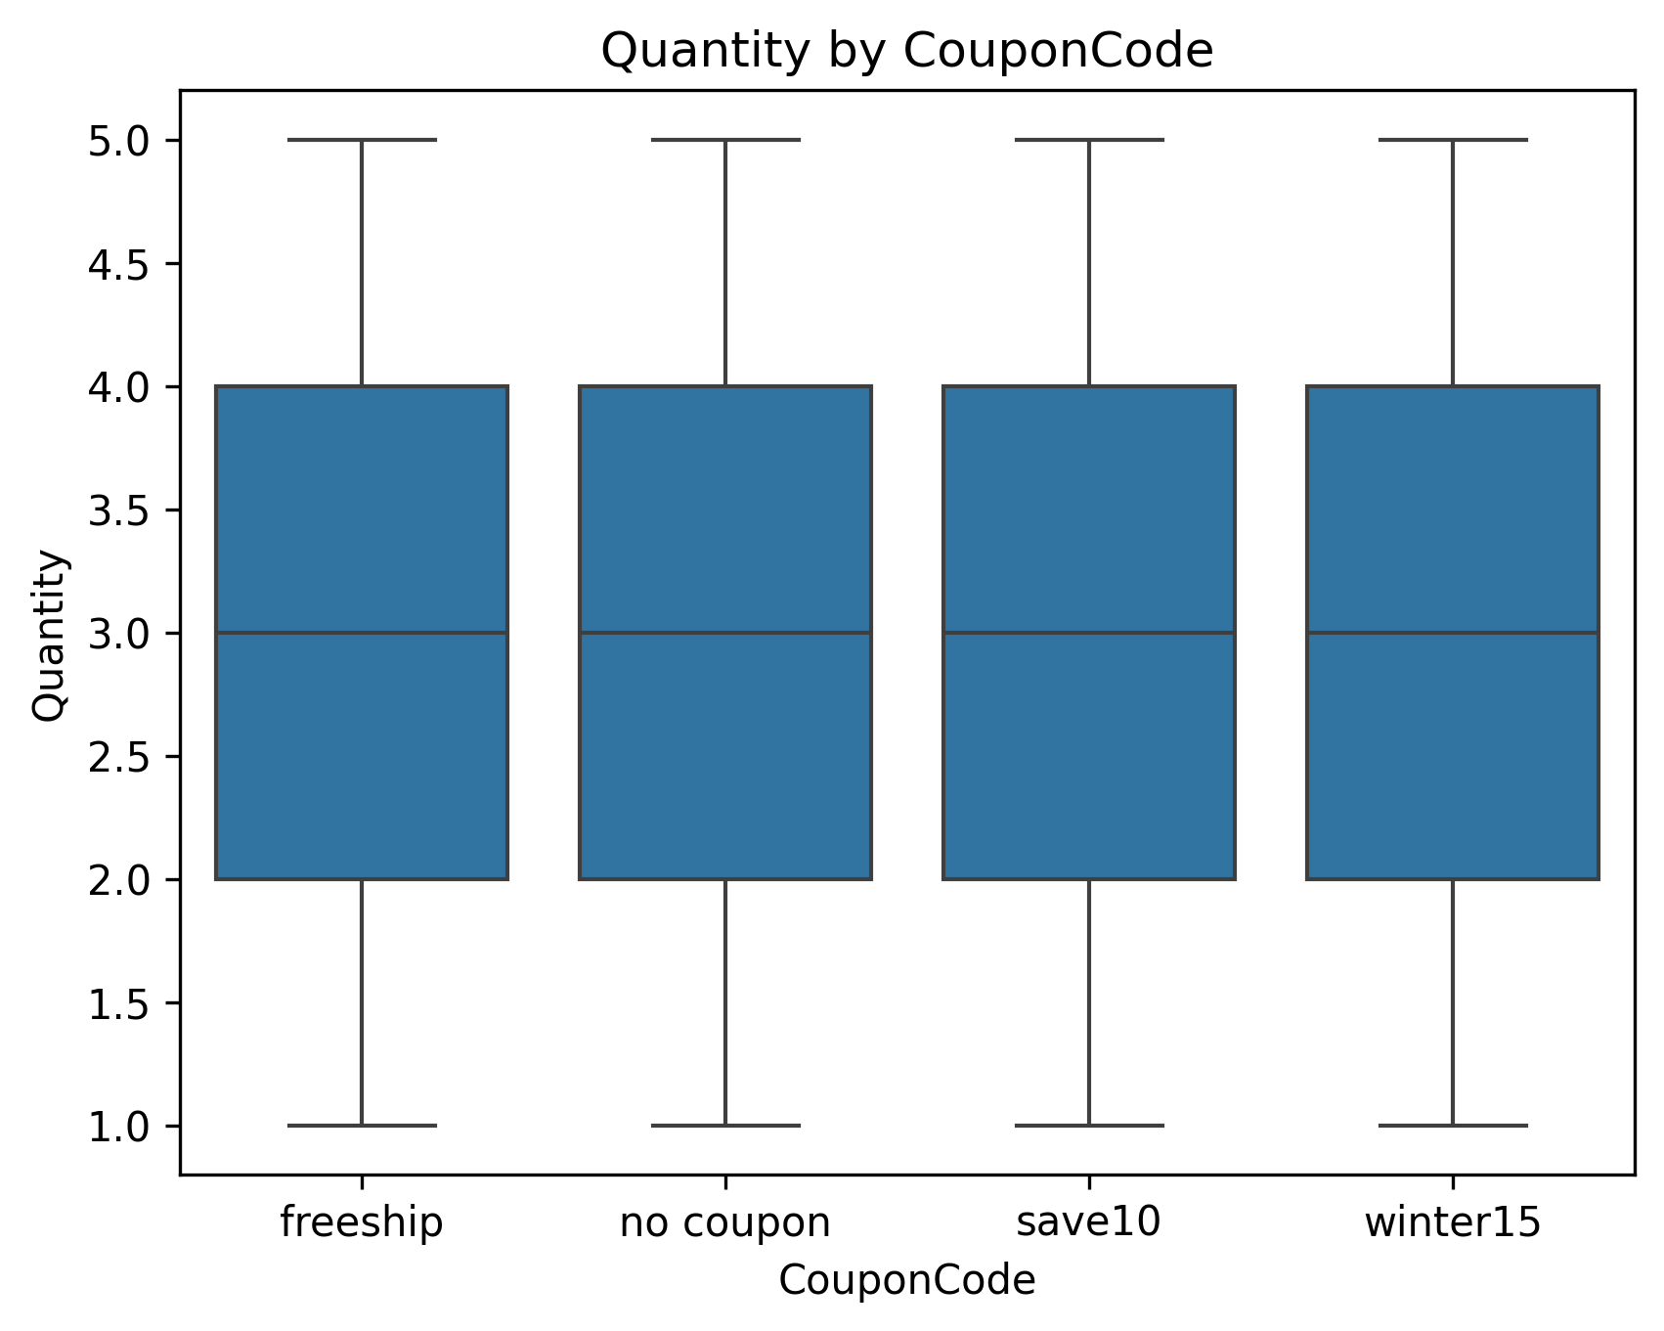
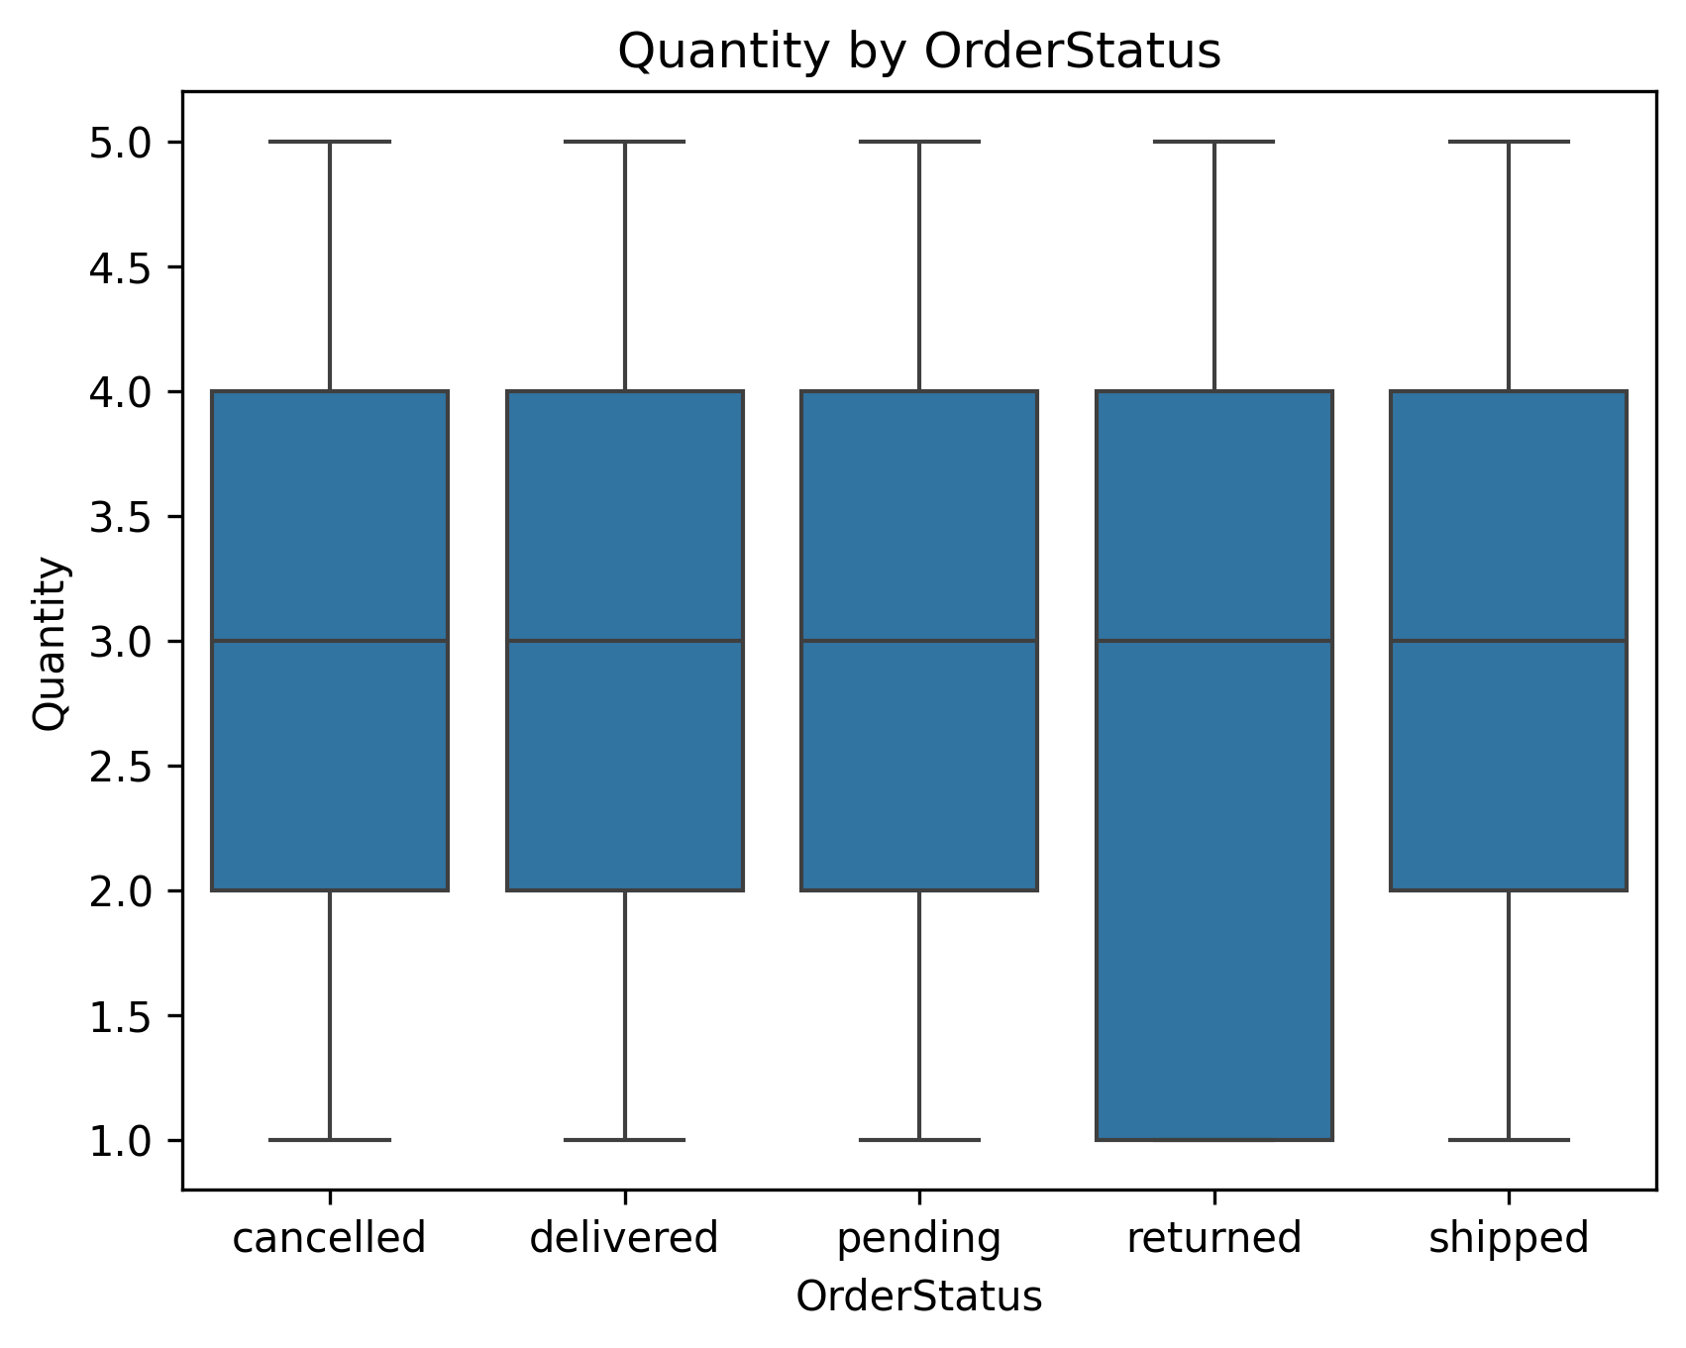

These four figures are boxplots for Quantity divided among several categories which shows that there no outliers for Quantity for all our categories
Notes:
1

Slide 12
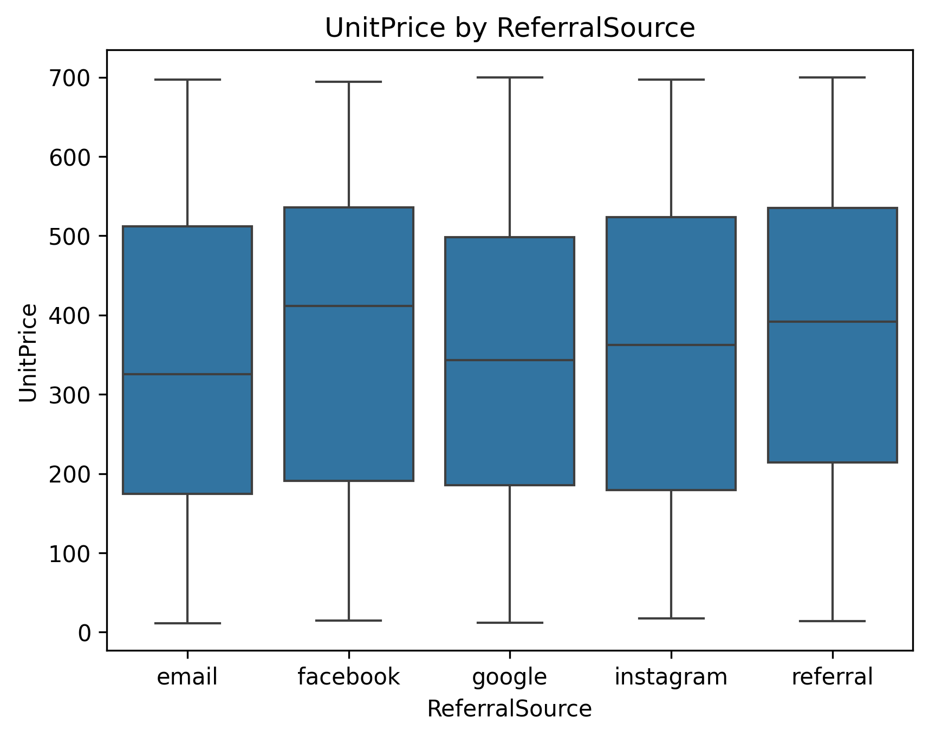
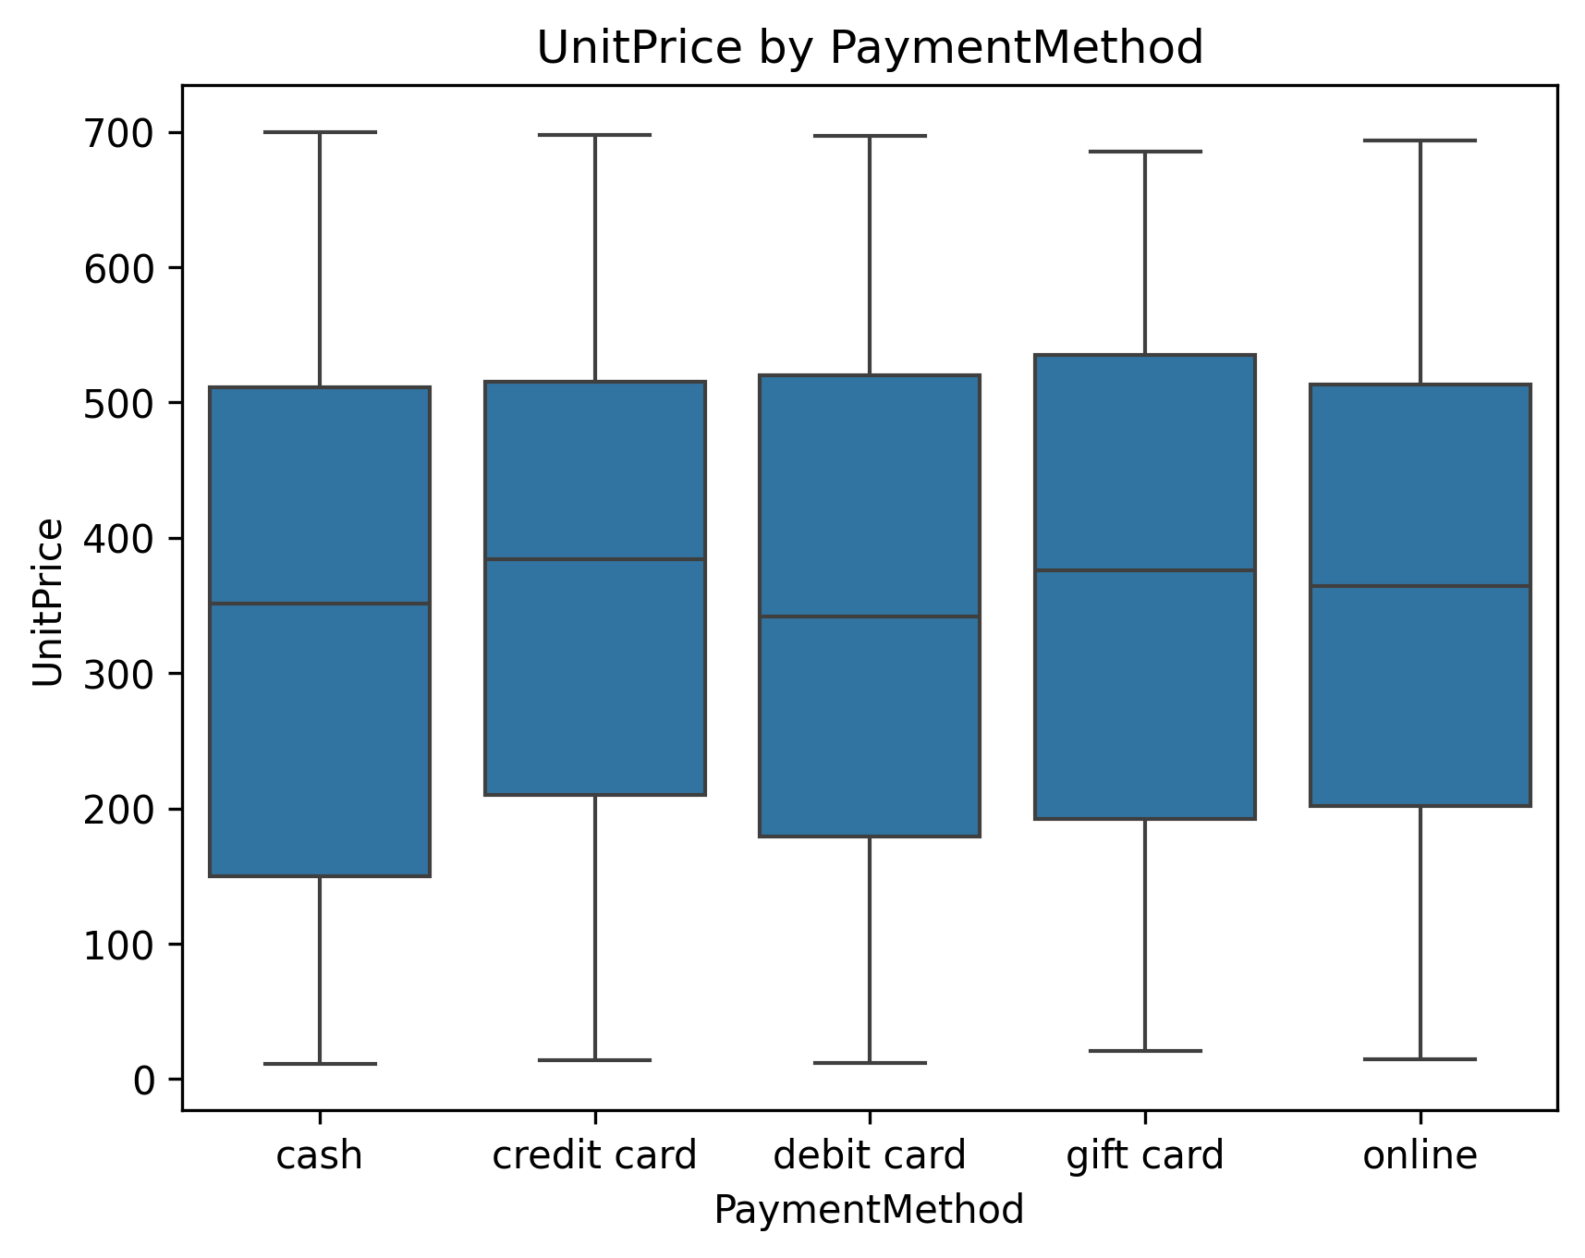
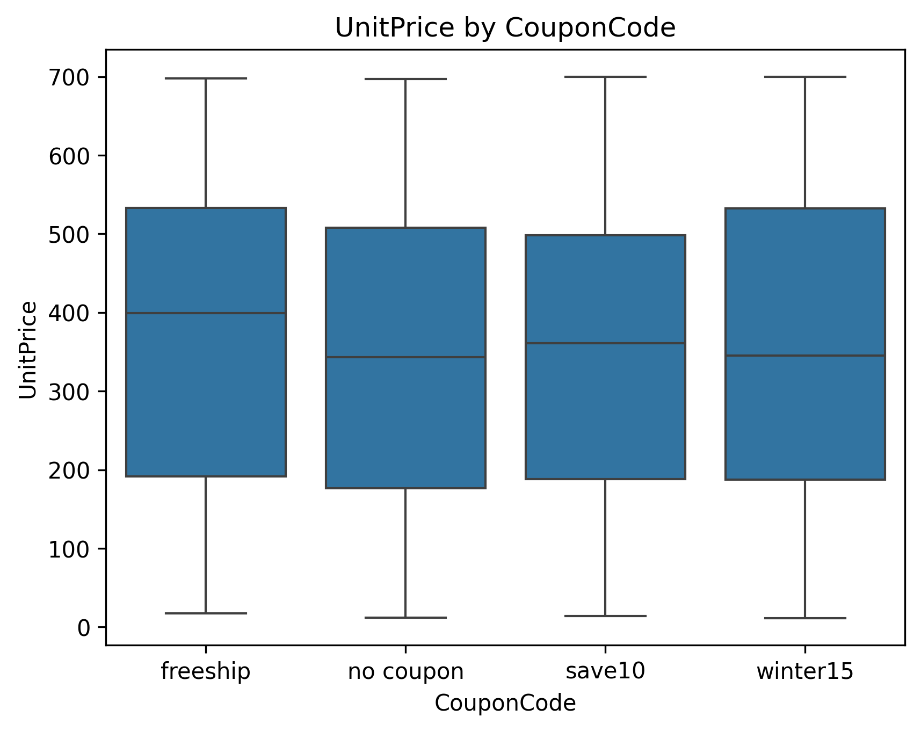
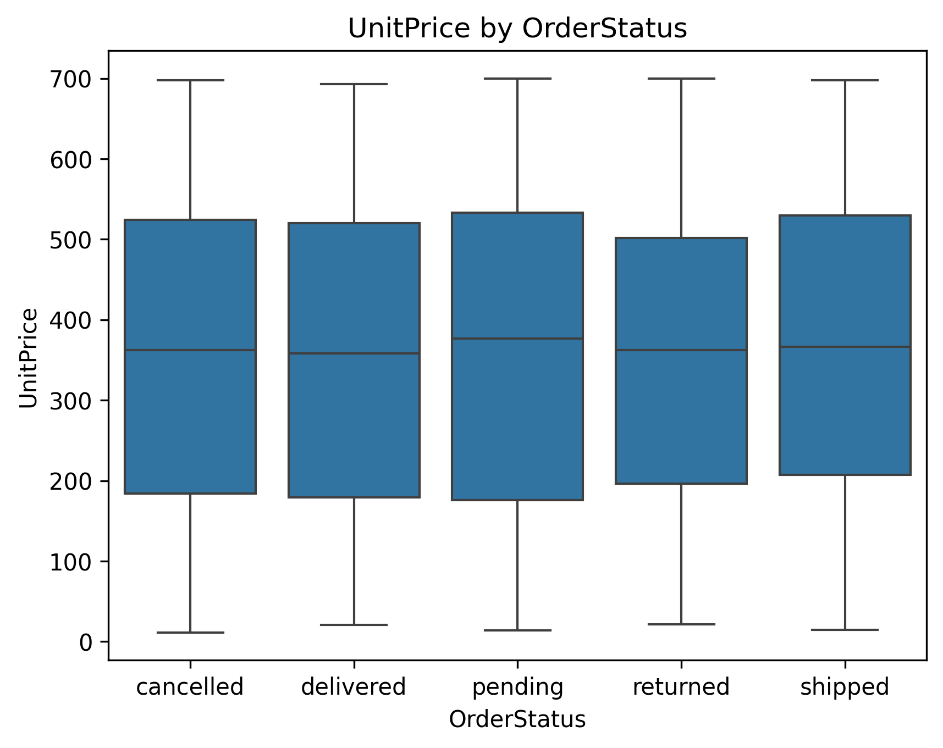
These four figures are boxplots for Unit price divided among several categories which shows that there no outliers for Unit price for all our categories
Notes:
1

Slide 13
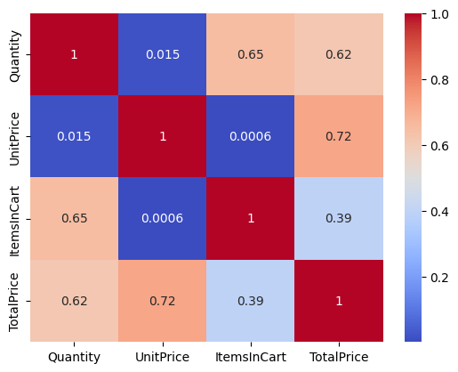
Correlation Heatmap for Quantity, unit price, Items in cart, Total price
This figure is a heatmap showing the correlation between several variables in which the higher the number the stronger the linear relation excluding main diagonal because each variable correlates perfectly with itself.
Notes:
1

Slide 14
Conclusion:
Successfully cleaned and prepared the dataset for analysis by handling missing values, checking duplicates, and correcting data types.
Applied descriptive statistical analysis to better understand both numeric and categorical variables.
Explored data distributions using histograms and identified variability and extreme observations through boxplots
Detected and analyzed outliers mathematically using the Interquartile Range (IQR) method and visually through charts
Compared numeric variables across different categories to identify behavioral differences and unusual patterns.
Investigated relationships between variables using a correlation heatmap to better understand dependencies within the dataset.
Followed a structured and organized analytical workflow from data cleaning to visualization and interpretation.
This project demonstrates the importance of Exploratory Data Analysis in transforming raw data into meaningful insights, supporting accurate interpretation, better decision-making, and preparation for future advanced analysis.
The goal was not only to visualize the data, but also to understand its structure, detect anomalies, and extract meaningful insights through a systematic analytical process.
Notes:
1

